Slide 1
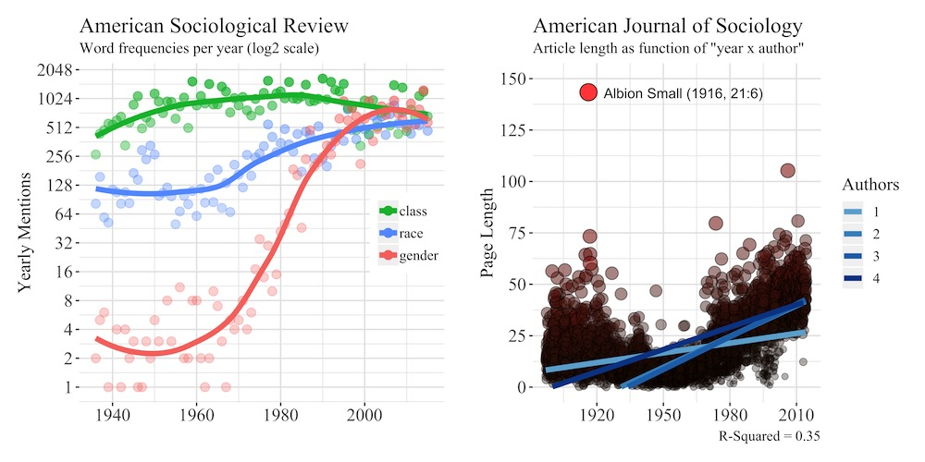
Data Visualization in R
John A. Bernau, PhD
Postdoctoral Fellow in Digital Scholarship
Center for the Study of Law and Religion
Emory University
john.bernau@emory.edu

Slide 2
Data Visualization in R
Today’s Outline
Why visualize?
For you…
For them…
For everyone!
How to visualize?
Working with data
Using R
Using ggplot2 (and the tidyverse)
Data visualization in the wild
Newspapers (WSJ, NYT)
Websites (The Pudding, RBloggers, etc.)
People (TP, HW)
Resources (PDF)
Workshop outline
Data wrangling: 10 VERBS (dplyr)
Data visualization: GRAMMAR (ggplot2)
Internal examples
External examples
Mini cooper prices
JSTOR data
Newspaper word frequencies

Slide 3
For you…

Slide 4

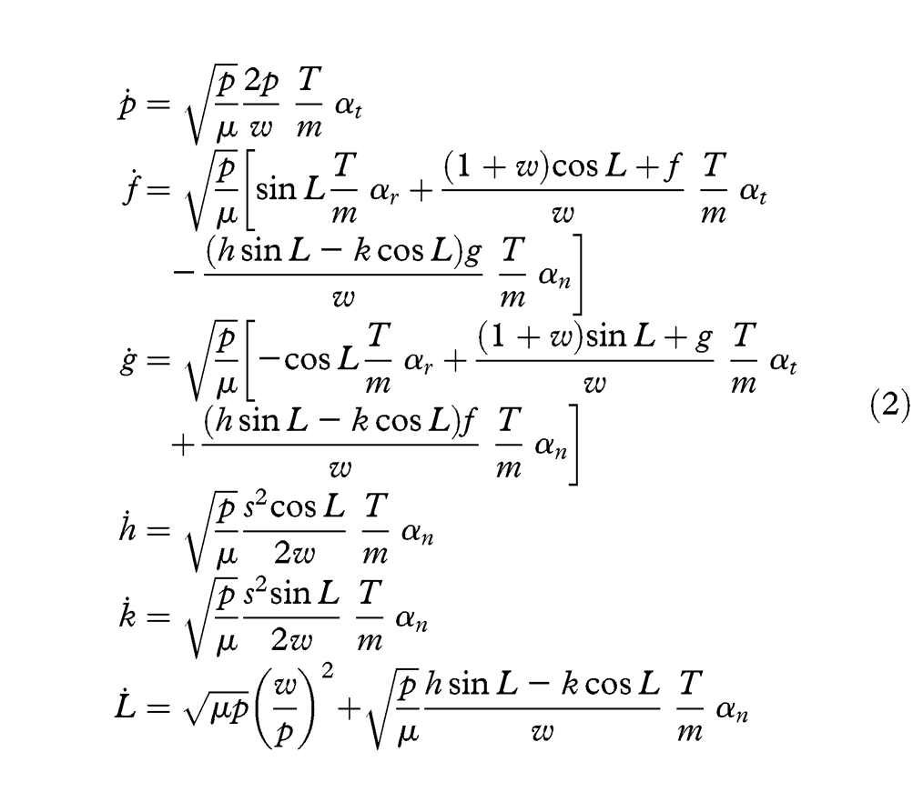
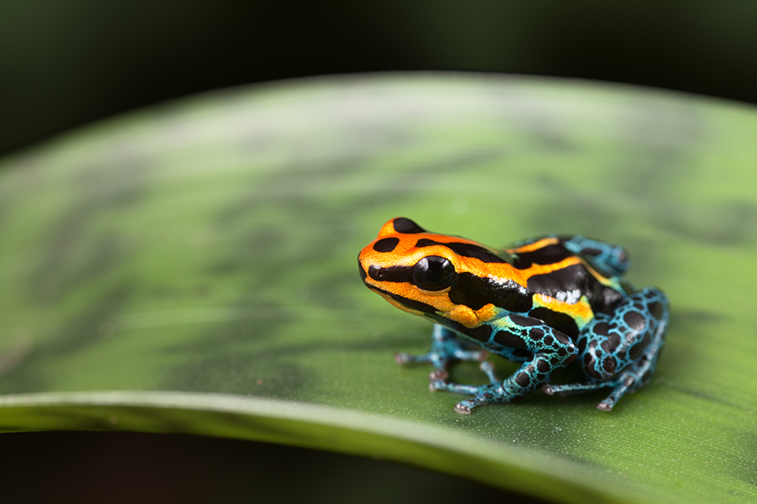

Slide 5
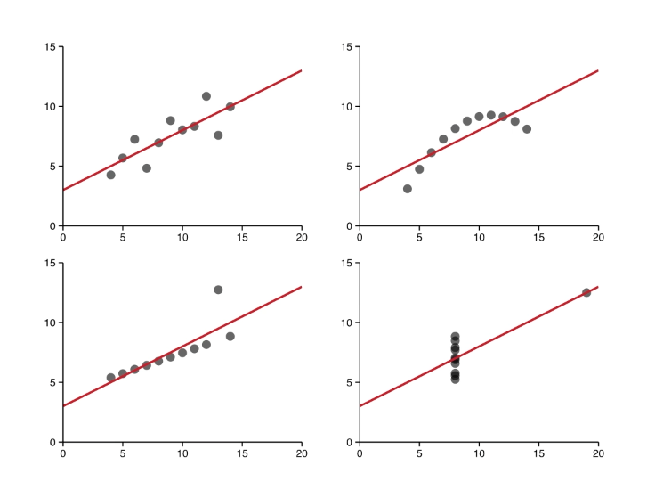
Notes:
At its most basic, visualization can be an essential tool for data exploration. While summary statistics might produce the same results, the actual data may look quite different.

Slide 6

Notes:
At its most basic, visualization can be an essential tool for data exploration. While summary statistics might produce the same results, the actual data may look quite different.

Slide 7
For them…

Slide 8
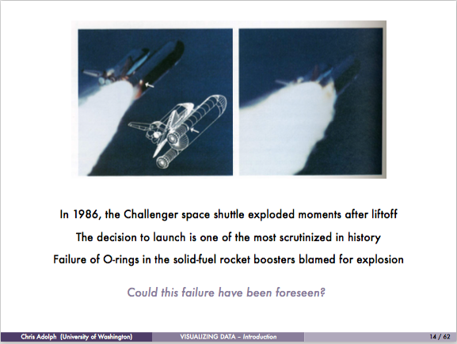
Notes:
The following slides are borrowed from Chris Adolph.
To take an example, consider the Challenger explosion of 1986.

Slide 9
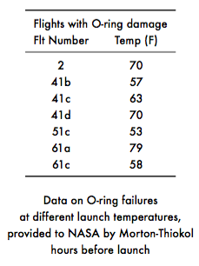
Notes:
When asked about the risk of O-ring failure, this was the chart presented to NASA. Is it helpful? What did you learn about O-ring damage and it’s relationship to temperature?
This is what we call “selecting on the dependent variable.” It only shows the flights with damage! What about the safe ones? Without this information we can’t understand it’s relationship to temperature. Furthermore, half of the data presented is irrelevant- why should we care about flight number when trying to determine safe launch temps?

Slide 10
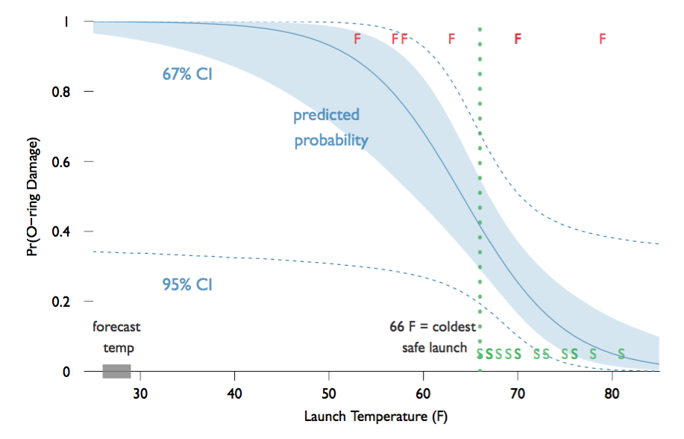
Notes:
Going a step further, this visualization contains all the essential information. We can see the previous launches, their outcome, and temperature signified by green S’s and red F’s. We can see the predicted probability, and two surrounding confidence intervals. This visualization also labels the coldest safe launch (66 degrees) and the forecasted temperature (25 degrees).
Now the team can talk about important questions: what is an acceptable amount of risk? Would NASA’s decision to launch be different if they were handed this graph?

Slide 11
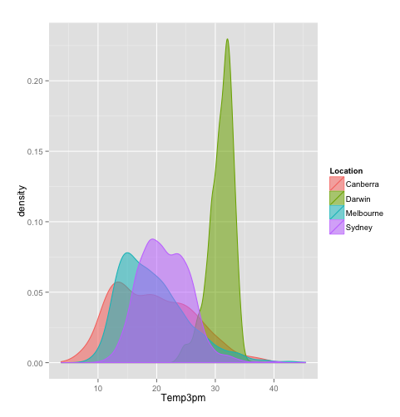
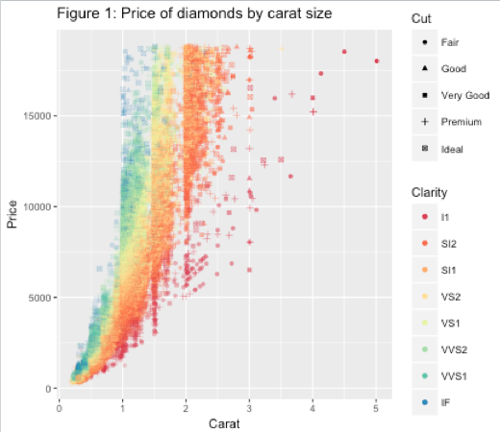
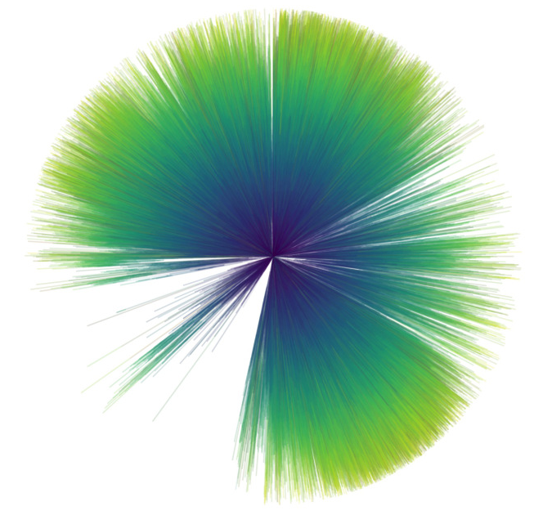
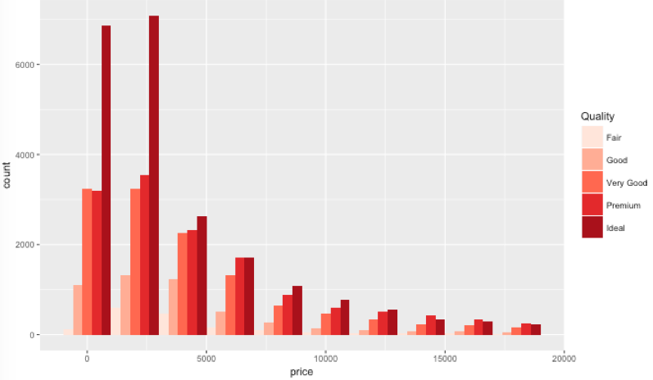
For everyone!

Slide 12
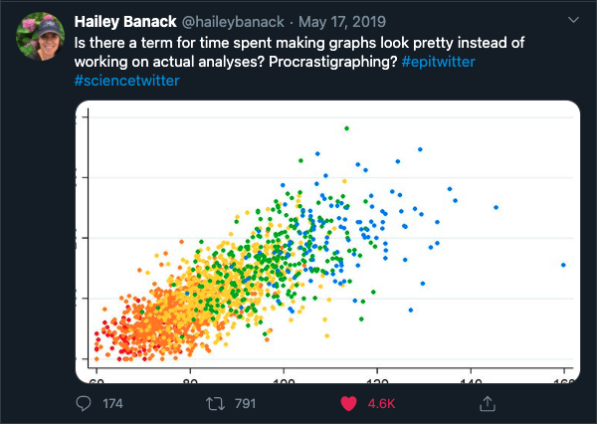

Slide 13
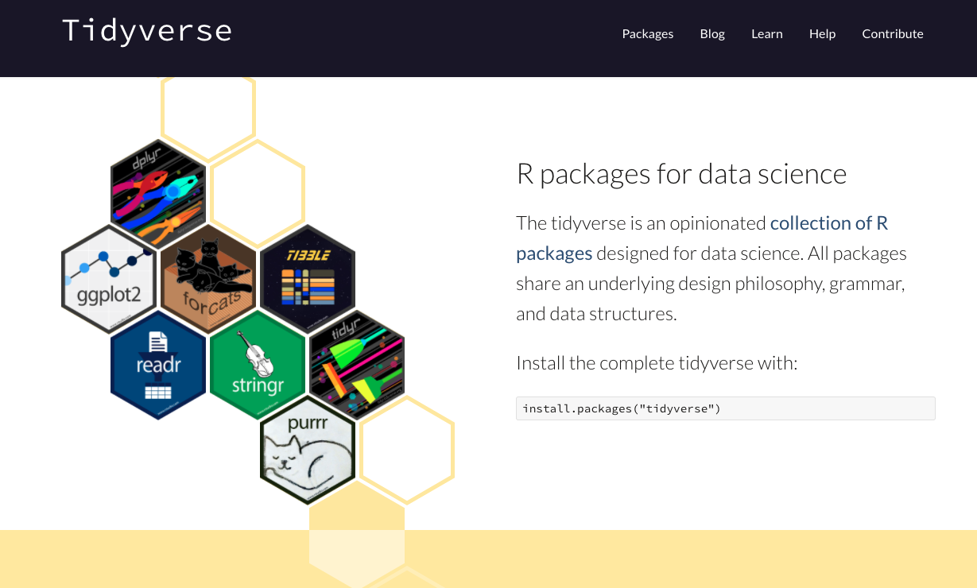

How to visualize…

Slide 14




Data Visualization in the Wild
Notes:
https://twitter.com/thomasp85
https://www.nytimes.com/section/upshot
https://twitter.com/WSJGraphics
https://pudding.cool/
https://pudding.cool/2017/07/comics/
Edward Tufte
Hans Rosling

Slide 15
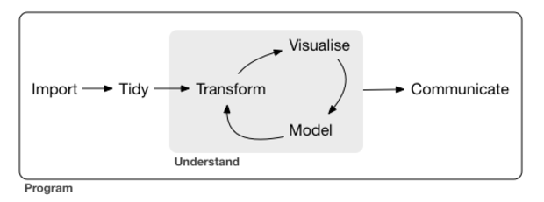

Workshop Outline
Workshop outline
Data wrangling: 10 VERBS (dplyr)
Data visualization: GRAMMAR (ggplot2)
Internal examples
External examples
Mini cooper prices
JSTOR data
Newspaper word frequencies
Source: http://r4ds.had.co.nz/index.html

